Slide 1
Understanding Human Behaviour Course Code: NHSI 103
Unit 1: INTRODUCTION

Slide 2
What is Psychology?
“psyche” is Greek for breath of life or soul
The scientific study of the mental processes, behaviour and the relationship between them
Both a natural science (studying the laws of nature) and social science (study of thoughts, feelings and behaviours of people)
The first formal psychological laboratory was founded in 1879 by Wilhelm Wundt, a psychologist and philosopher at the University of Leipzig in Germany
Notes:
Behavior includes all of our outward or overt actions and reactions, such as talking, facial expressions, and movement. The term mental processes refers to all the internal, covert (hidden) activity of our minds, such as thinking, feeling, and remembering.
Psychology not only helps you understand why people (and animals) do the things they do, but it also helps you better understand yourself and your reactions to others.
Psychology can help you comprehend how your brain and body are connected, how to improve your learning abilities and memory, and how to deal with the stresses of life, both ordinary and extraordinary.
In studying psychology, an understanding of the methods psychologists use is crucial because research can be flawed, and knowing how research should be done can bring those flaws to light.
And finally, psychology and its research methods promote critical thinking, which can be used to evaluate not just research but also claims of all kinds, including those of advertisers and politicians.

Slide 3
Major Perspectives in Psychology

Slide 4
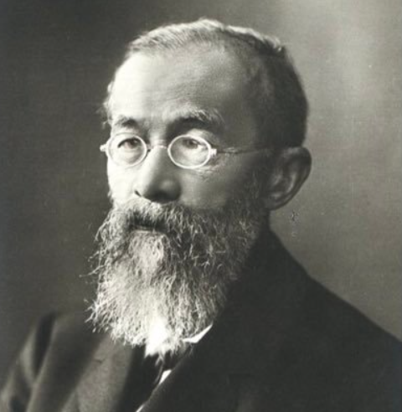
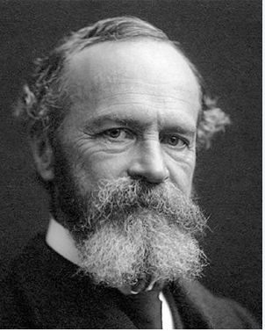
Earliest perspectives
Structuralism
Wilhelm Wundt (Father of Experimental Psychology)
Content (structure) of consciousness
Objective Introspection
Edward Titchener – Structuralism
Functionalism
William James
Function of consciousness - how the mind allows people to adapt, live, work, and play
Notes:
Wundt believed that consciousness, the state of being aware of external events, could be broken down into thoughts, experiences, emotions, and other basic elements. In order to inspect these nonphysical elements, students had to learn to think objectively about their own thoughts—after all, they could hardly read someone else’s mind. Wundt called this process objective introspection, the process of objectively examining and measuring one’s own thoughts and mental activities
Tichener believed that every experience could be broken down into its individual emotions and sensations
James: . Conscious ideas are constantly flowing in an ever-changing stream, and once you start thinking about what you were just thinking about, what you were thinking about is no longer what you were thinking about—it’s what you are thinking about—and … excuse me, I’m a little dizzy. I think you get the picture, anyway

Slide 5
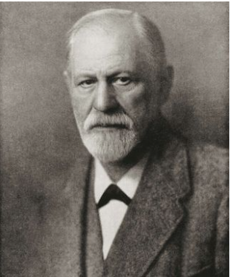
Psychodynamic Perspective
Sigmund Freud
Behavior influenced by unconscious motives and desires
Inner conflicts
Dreams, Slips of tongue
Defense Mechanisms
Modernised version of psychoanalytical perspective

Slide 6
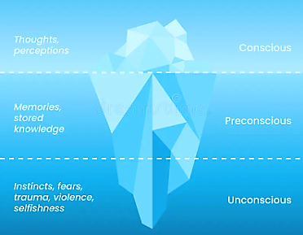
Psychoanalytic Theory: Iceberg Analogy

Slide 7
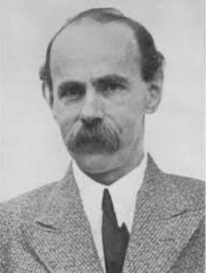
Gestalt Psychology
Max Wertheimer, Kurt Koffka, & Wolfgang Kohler
German meaning “an organised whole”
Psychological events can only be studied in ‘whole’
Perception of patterns and whole figures
Led foundations of cognitive psychology
5 gestalt principles: proximity, similarity, closure, continuity, common region
Notes:
The whole is greater than sum of its parts
Mobile phone analogy

Slide 8
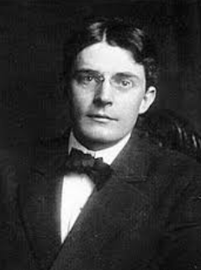
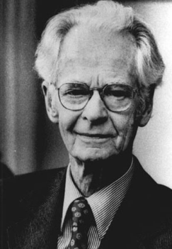
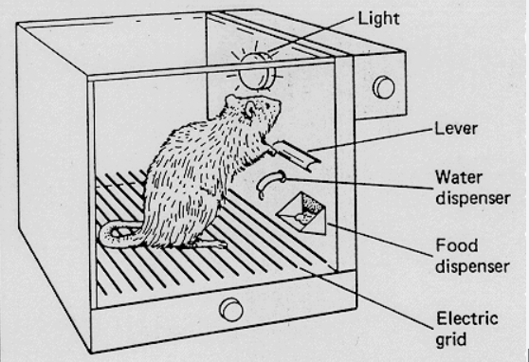
Behaviorism
John B. Watson; B. F. Skinner
Only observable behaviour should be studied
Overt responses to stimuli
Rejected the idea of studying internal mental states, since they can neither be observed nor examined scientifically
Conditioning and reinforcement
Skinner’s box

Slide 9
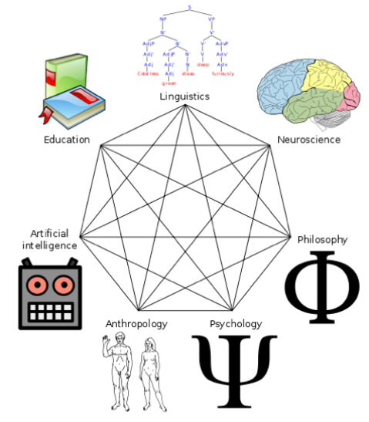
Cognitive Perspective
Arose in reaction to behaviourism
Focused on how people think, understand and acquire knowledge
Behaviour influenced by cognitive processes
How we process the world around us
Focuses on memory, intelligence, perception, problem-solving, and learning
AI and computer models used to explain mental processes
Notes:
Behaviour is the outcome of mental processes

Slide 10
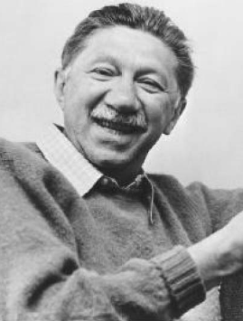
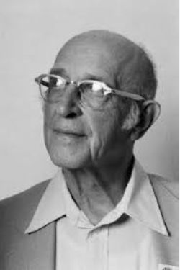
Humanistic Perspective
Abraham Maslow; Carl Rogers
Free will and self-fulfilment
Humans motivated by the desire for personal growth
Naturally strive to grow and develop
Self-concept and positive regard
Hierarchy of needs and self-actualisation

Slide 11
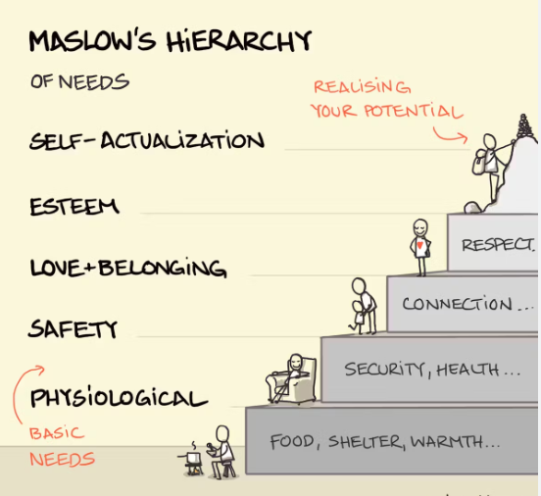

Slide 12
Studying Behaviour

Slide 13
Understanding Human Behaviour - provides a new way of thinking about your own feelings, thoughts, and actions, plus those of other persons
This new way of thinking will enrich your life in many different ways.
Key Focus of this section - Research Methods psychologists use in their efforts to add to our knowledge of human behavior
Studying human behaviour - Common Sense may give a confusing and incorrect human behaviour
Example - Confirmation Bias or Availability Heuristics or Mood Effects
The solution is - Studying human behaviour using Scientific Method
Essential Components of Scientific Method
Accuracy - Error free information
Objectivity - Bias free information
Skepticism - Information is verified from various sources
Open Mindedness - openness to change one’s own view

Slide 14
The basis of Scientific Method in studying behaviour - Critical Thinking
Critical Thinking - thinking that avoids blind acceptance of conclusions or arguments and instead closely examines all assumptions, carefully evaluates existing evidence, and cautiously assesses all conclusions.
Critical Thinking involves following guidelines -
Never jump to conclusions
Keep an open mind
Always ask “HOW”
Be skeptical
Never be stampeded into accepting some view or position by your own emotions
Critical Thinking is scientific study of human behaviour in everyday life, but how Psychologists study human behaviour?

Slide 15
Psychologists study Behaviour through -
Observation - observation accompanied by careful, accurate measurements
Naturalistic Observation - systematic study of behavior in natural settings
Example - observing student’s attention in a class
Case Studies - A method of research in which detailed information about individuals is used to develop general principles about behavior
Survey Method - A research method in which large numbers of people answer questions about aspects of their views or their behavior
Correlation - A research method in which researchers attempt to determine whether, and to what extent, different variables are related to each other.
Example - Watching lots of TV increase heart attack rates.
(Even If Two Variables Are Strongly Correlated, This Does Not Necessarily Mean That Changes in One Cause Changes in the Other)
Experimental Method - A research method in which researchers systematically alter one or more variables (or Independent Variable) in order to determine whether such changes influence some aspect of behavior (or Dependent Variable)
Example - to check whether practicing meditation improves working memory

Slide 16
Branches of Psychology

Slide 17
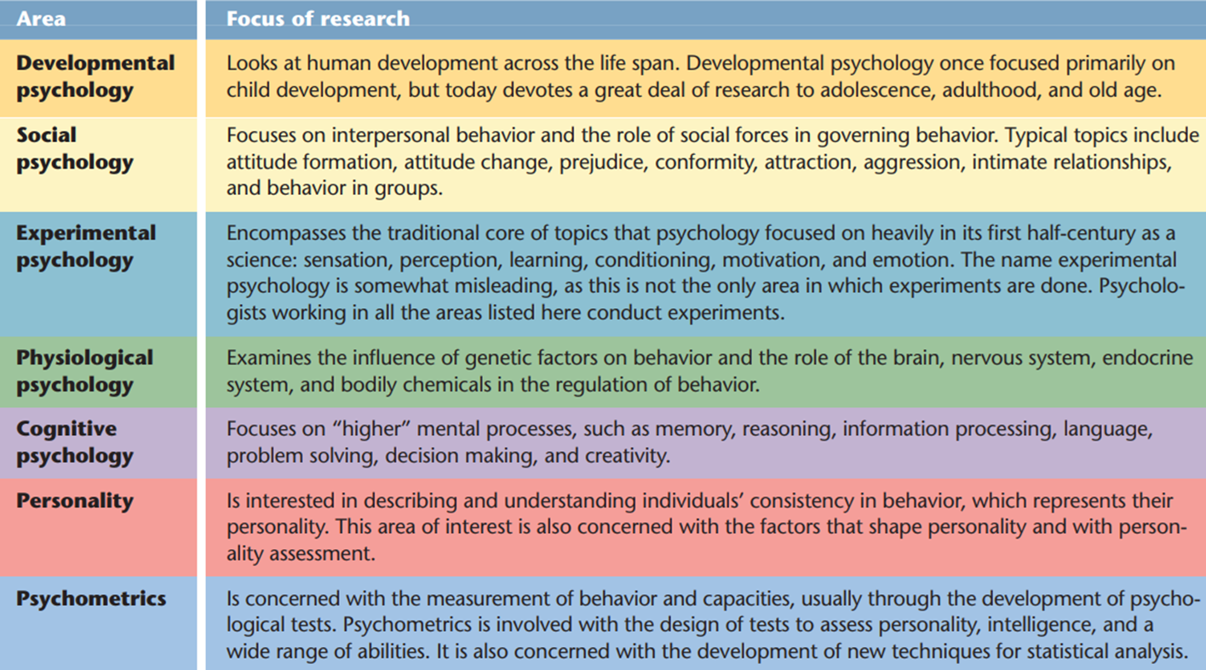
Notes:
Could mention other areas as well: Forensic psychology » Military psychology » Engineering and human factors » Couples and family psychology » Sports, exercise, and performance psychology » Clinical neuropsychology» Health psychology

Slide 18
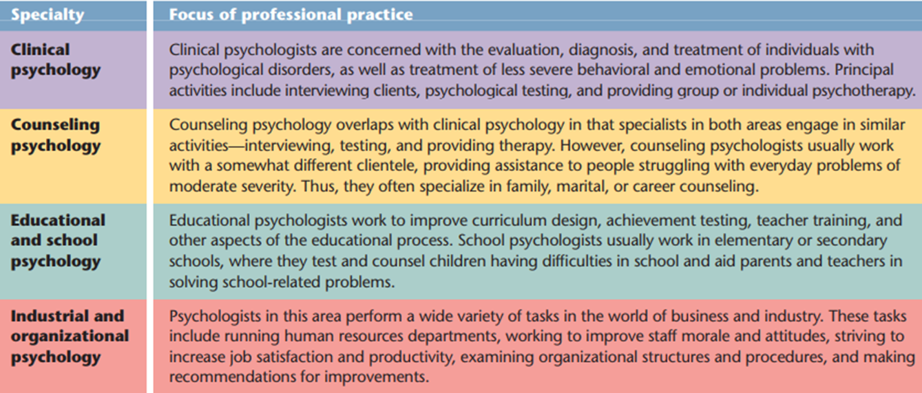
Notes:
Reference: Themes and Variations, can also refer to https://www.nu.edu/blog/branches-of-psychology/#two-major-areas-of-psychology, also, Baron (p.12)

